Slide 1
Introduction to Probability Theory
Probability theory is the branch of mathematics that deals with predicting the likelihood of different outcomes in uncertain situations. It's the science of chance and uncertainty, providing tools to model and analyze random events.
Key Concepts:
Experiment: Any process with uncertain outcomes that can be repeated under identical conditions.
Example: Tossing a coin, rolling a die, or picking a card from a deck.
Sample Space (S): The set of all possible outcomes of an experiment.
Example: For a coin toss, S={Heads, Tails} For rolling a die, S={1,2,3,4,5,6}

Slide 2
What is an Event?
Event (E): A subset of the sample space. An event is a specific outcome or group of outcomes.
Example: Rolling an even number (E={2,4,6}).
Probability (P): A measure of how likely an event is to occur. The probability of an event is calculated as:
P(E)=Number of favorable outcomes/Total number of outcomes in S
Example: For rolling a die, the probability of rolling a 3 is: P(3)=1/6​
​

Slide 3
Analogy: Probability as Weather Prediction
Think of probability as the weather forecast. If a weather app says there’s a 70% chance of rain, it doesn't guarantee it will rain but tells you that in similar past situations, it rained 7 out of 10 times. Similarly, probability predicts likelihood based on past patterns or theoretical analysis.

Slide 4
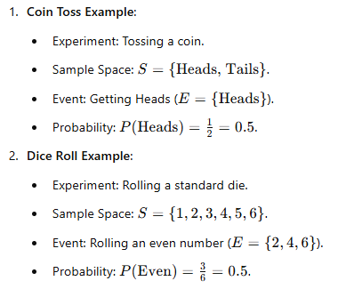
Examples in Probability

Slide 5
Types of Probability
Theoretical Probability: Based on mathematical reasoning.
Example: Rolling a fair die, each number has an equal chance of 1/6.
Experimental Probability: Based on actual experiments or historical data.
Example: Observing that it rains 30 out of 100 days, so the probability of rain is 30/100=0.3
Subjective Probability: Based on personal judgment or belief.
Example: "I think there’s a 70% chance my favorite team will win today."

Slide 6
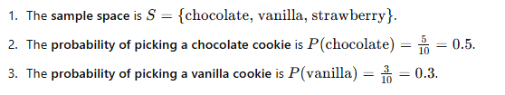
Analogy: Probability as a Cookie Jar
Imagine a jar containing 10 cookies: 5 chocolate, 3 vanilla, and 2 strawberry. If you randomly pick one cookie:

Slide 7
Practical Applications of Probability
Games of Chance: Predicting outcomes in lotteries, dice games, or poker.
Weather Forecasting: Estimating the likelihood of rain or sunshine.
Risk Assessment: Evaluating risks in business, finance, or insurance.
Medicine: Calculating the likelihood of a disease based on symptoms or genetic data.

Slide 8
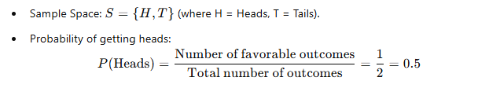
Exercise
Q1: You toss a fair coin. What is the sample space for this random experiment, and what is the probability of getting heads?

Slide 9
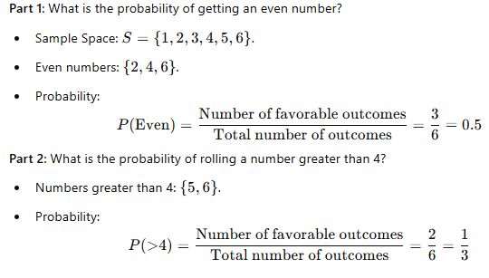
Q2: A 6-sided die is rolled once.

Slide 10

Q3: A bag contains 3 red balls, 4 blue balls, and 5 green balls. One ball is drawn randomly.
Part 1: What is the sample space for this random experiment?

Slide 11
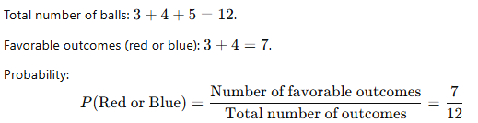
Part 2: What is the probability of drawing either a red or a blue ball?

Slide 12
Compound Events in Probability
A compound event in probability refers to an event that involves the combination of two or more simple events. These events can either occur together, one after the other, or depend on certain conditions. The probability of a compound event depends on whether the events involved are independent or dependent and whether they are connected by "AND" or "OR."

Slide 13
Types of Compound Events
Union of Events (OR)
The event occurs if any one of the events happens.
Example: Drawing a card that is either a King OR a Spade.
Intersection of Events (AND)
The event occurs if all events happen simultaneously.
Example: Rolling a die and getting an even number AND a number greater than 3.

Slide 14

Example 1: Union (OR)
Scenario: Imagine you’re deciding which movie to watch this weekend. You will watch a movie if:
It is a comedy.
OR it has your favorite actor.
This is a compound event connected by "OR." Even if a movie isn’t a comedy, you’ll still watch it if your favorite actor is in it.
In Probability Terms:
Event A: The movie is a comedy.
Event B: The movie has your favorite actor.

Slide 15
Example 2: Intersection (AND) with an Analogy
Scenario: Suppose you are preparing a sandwich. You will eat the sandwich only if:
It has bread, AND
It has cheese.
This is a compound event connected by "AND." Both conditions must be met for you to eat the sandwich.
In Probability Terms:
Event A: The sandwich has bread.
Event B: The sandwich has cheese.
If A and B are independent events:

Slide 16
Multiplication Rule: Independent Events in Probability
In probability theory, independent events are events that have no influence on each other. This means the occurrence (or non-occurrence) of one event does not affect the probability of the other event happening.
Mathematically, two events A and B are independent if:
P(A∩B)=P(A)⋅P(B)
This means the probability that both AAA and BBB occur is simply the product of their individual probabilities.

Slide 17
Key Characteristics of Independent Events:
No influence: The outcome of one event does not affect the outcome of the other.
Multiplication rule: The probability of both events occurring together is the product of their individual probabilities.

Slide 18
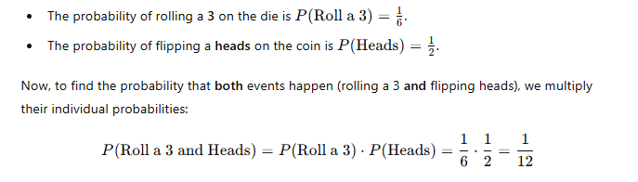
Rolling a Die and Flipping a Coin
Imagine you are rolling a die and flipping a coin at the same time. These two events (rolling the die and flipping the coin) are independent events.

Slide 19
Key Points to Remember about Independent Events
Multiplication Rule: If events A and B are independent, the probability of both events occurring is the product of their individual probabilities.
P(A∩B)=P(A)⋅P(B)
No Influence: The occurrence of one event has no effect on the occurrence of the other.
Independence vs. Dependence: If two events are dependent, the occurrence of one event affects the probability of the other event. For dependent events, the formula changes, and you need to account for the conditional probability.

Slide 20
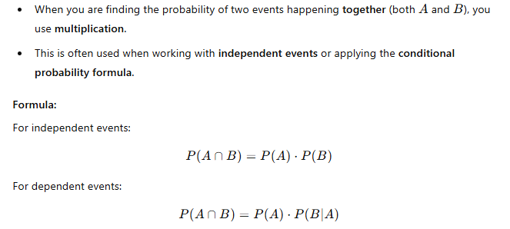
1. Multiplication Rule: For "And" (Joint Events or Intersection)

Slide 21

Example
Rolling a die and flipping a coin:

Slide 22


2. Addition: For "Or" (Union of Events)
When you are finding the probability of either one event or another happening (at least one of them), you use addition.
However, if the events can occur simultaneously, you must subtract the overlap to avoid double-counting.
Formula:
For any two events which NOT Mutually Exclusive:
For any two events which Mutually Exclusive:

Slide 23
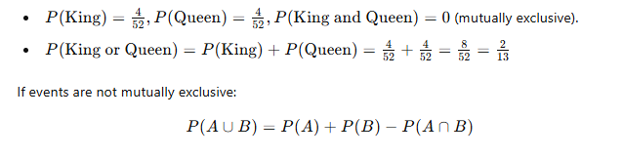
Example: Drawing a King or a Queen from a deck of cards:

Slide 24
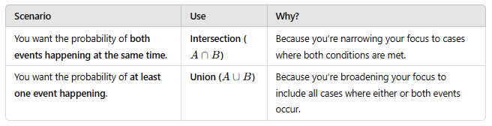
Key Differences (When to Use What):

Slide 25
Practical Questions to Decide
1. When to Use Intersection?
Q: What’s the chance that a person is both a college graduate and employed?
Why: You want the probability of both conditions being satisfied.
2. When to Use Union?
Q: What’s the chance that a person is either a college graduate or employed?
Why: You want the probability of at least one condition being satisfied.

Slide 26
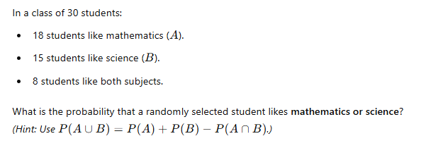
Union Questions (A∪B): Example 1

Slide 27
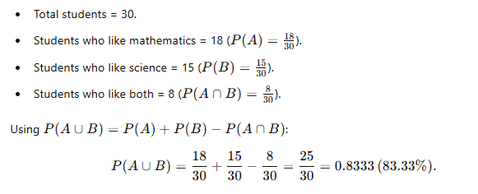
Solution

Slide 28
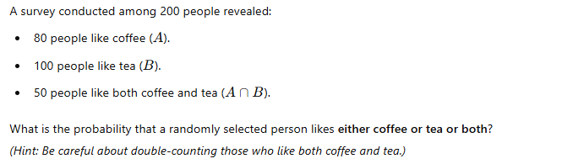
Example 2

Slide 29
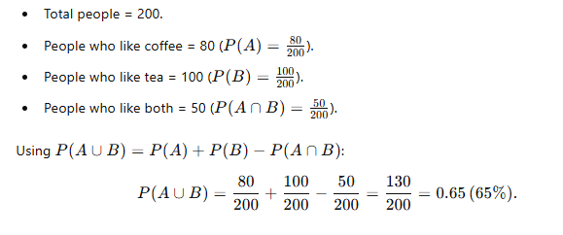
Solution

Slide 30
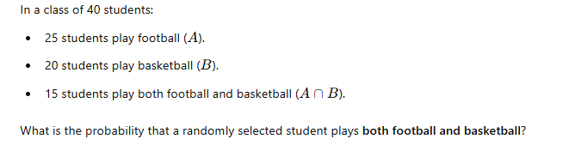
Intersection Questions (A∩BA): Example 1

Slide 31
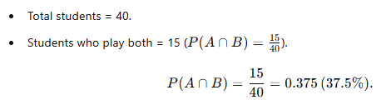
Solution

Slide 32
Scenario: Chocolate Prize for Students
Given Conditions:
Students must have attended all classes this month (A).
Students must have scored 90% or higher on the test (B).

Slide 33
Two Cases to Consider

Slide 34
Case 1: Independent Events
The probability of one event does not affect the probability of the other, i.e., P(A∩B)=P(A)⋅P(B)

Slide 35
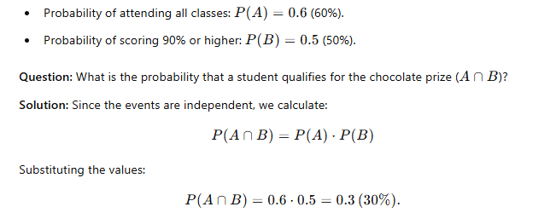
Example

Slide 36
Case 2: Dependent Events
Definition of Dependence: The probability of one event affects the probability of the other, i.e., P(A∩B)=P(A)⋅P(B∣A)

Slide 37
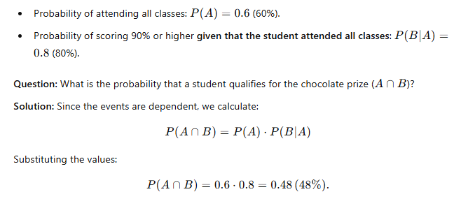
Example:

Slide 38
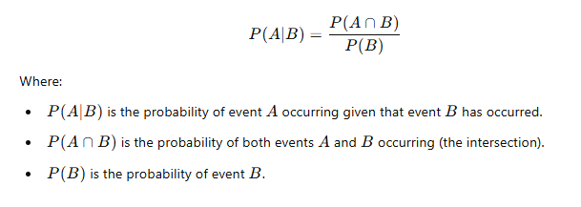
Conditional Probability
Definition of Conditional Probability
Conditional probability is the probability of an event occurring, given that another event has already occurred. It helps us understand the likelihood of an event under specific conditions or constraints.
Mathematically, the conditional probability of event A given that event B has already occurred is denoted as:

